Slide 1
INTRODUCTION
Notes:
Introduction to parallel programming and OpenACC. This is a very conceptual approach, and is intended for students with little to no parallel programming experience.

Slide 2
MODULE OVERVIEW
Topics to be covered
Introduction to parallel programming
Common difficulties in parallel programming
Introduction to OpenACC
Parallel programming in OpenACC
Notes:
This module is designed for a complete beginner to parallel programming and to OpenACC. If students are already familiar with parallel programming, it is understandable to skip directly to the section labeled “Introduction to OpenACC.”
Students who are already familiar with parallel programming, and know what OpenACC is, then this chapter might be skippable entirely.

Slide 3
INTRODUCTION TO PARALLEL PROGRAMMING
Notes:
The goal is to introduce parallel programing/parallelism at a very high level. We aim to give students a background of what parallelism is, and what the goals of parallel programming are. Later modules will give more specific details of parallel programming, and how to use OpenACC as a parallel programming platform.

Slide 4
WHAT IS PARALLEL PROGRAMMING?
“Performance Programming”
Parallel programming involves exposing an algorithm’s ability to execute in parallel
This may involve breaking a large operation into smaller tasks (task parallelism)
Or doing the same operation on multiple data elements (data parallelism)
Parallel execution enables better performance on modern hardware
A + B + C + D
Sequential
Parallel
A
B
C
D
A
B
C
D
2 Steps
3 Steps
Notes:
Parallel programming is one way that programmers are increasing the performance of their programs.
The goal is to take an algorithm, or in other terms a computer program, and run certain parts of it “in parallel.” It is up to the programmer to identify which parts can be parallel, and depending on the programming platform being used, it may be up to the programmer to explicitly define that parallelism in code.
The main benefit of parallel programming is having the ability to run our code on parallel hardware (such as GPUs, multi/manycore CPUs, cloud computing servers, etc…). Parallel hardware is made to be high-performance hardware, and has been around for over a decade now.
The very simplified version of parallel programming is: “do many things at the same time.” When creating a parallel program, we are expecting to execute computer instructions in parallel. For example, being able to complete multiple addition operations at the same time.
Usually, the need for parallel programming comes from high-computational, time-intensive tasks. There are a lot of situations when this task is as simple as, “do a few billion mathematic operations.” While a single mathematical operation is trivial for a computer to process, completing several billion will prove to be difficult (or at least take awhile to complete). Our goal with parallel programming is to break that long, single task (billions of mathematical operations) into smaller tasks. Once we have our smaller tasks, we can complete those smaller tasks in parallel with one-another (at the same time).

Slide 5

A REAL WORLD CASE STUDY
Modern cancer research
The Russian Academy of Science created a program to simulate light propagation through human tissue
This program was used to be able to more accurately detect cancerous cells by simulating billions of random paths that the light could take through human tissue
With parallel programming, they were able to run thousands of these paths simultaneously
The sequential program took 2.5 hours to run
The parallel version took less than 2 minutes
Parallel Computing Illuminating a Path to Early Cancer Detection
Notes:
https://blogs.nvidia.com/blog/2011/02/11/parallel-computing-illuminating-a-path-to-early-cancer-detection/
This case study can be seen as relatively impactful, because it revolves around a very important topic: cancer research.
A little more background about this story: the procedure described in the article involves placing light beacons into human tissue. These lights will illuminate the tissue, and hopefully allow doctors to see cancerous cells. The placement of these beacons need to be very precise to be able to illuminate all of the deep tissue cells. Placing these beacons at random (or even based on the doctor’s best judgement) will be a “trial-and-error” situation. So these scientist developed a computer simulation to simulate the placement of these beacons. This means that the doctor does not have to repeatedly place beacons into the patient, rather, the computer would simulate the placement of the beacons, and output the most optimal placement.
The only problem was, the program took a long time to run. So the scientist parallelized the program using NVIDIA GPUs, and were able to get significantly better performance.
While not every programmer will be researching cancer, most programmers are looking to optimize their applications. Parallel programming is one very effective way of doing that.

Slide 6




WHAT IS PARALLEL PROGRAMMING?
A real world example
A professor and his 3 teaching assistants (TA) are grading 1,000 student exams
This exam has 8 questions on it
Let’s assume it takes 1 minute to grade 1 question on 1 exam
To maintain fairness, if someone grades a question (for example, question #1) then they must grade that question on all other exams
The following is a sequential version of exam grading
Prof
TA
x1000
8 questions per exam
8,000 questions in total
1 minute per question
Notes:
This is a very simple real-world example. Within the scope of parallel programming, this example would be considered “embarrassingly parallel” because it is very simple to parallelize. We will showcase a few timelines that will display the time needed to grade the exams in various configurations. The hope is that the students will understand why the parallel solution is good (performance wise), and to understand that while the parallel solution offers good performance, it also comes with a few, possibly unforeseen difficulties.

Slide 7
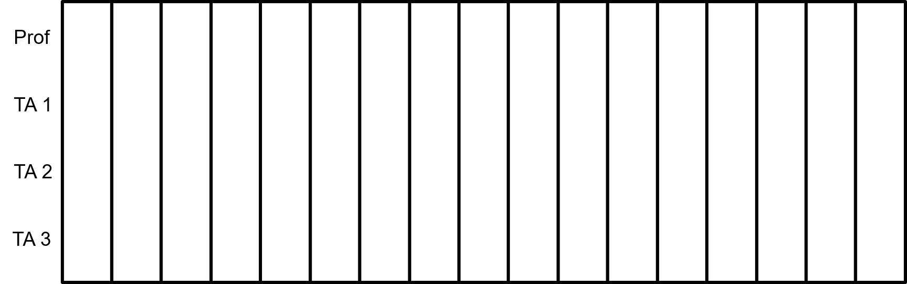
SEQUENTIAL SOLUTION
Grade Exams 1-1000 : Questions #1, 2, 3, 4, 5, 6, 7, 8 : 8000m
8000 m
Notes:
The professor grades all questions on all 1,000 exams. During this process, the TAs are not doing anything. This is the sequential solution to the problem, and offers very poor performance compared to what could be achieved. Also in terms of hardware occupancy, we are performing terribly, since only 25% of our “hardware” is active.
Maybe we can better utilize our available resources by assigning each question to a particular grader...

Slide 8
SEQUENTIAL SOLUTION
Exams 1-1000 : Q #1 : 1000m
Exams 1-1000 : Q #5 : 1000m
Exams 1-1000 : Q #2 : 1000m
Exams 1-1000 : Q #6 : 1000m
Exams 1-1000 : Q #3 : 1000m
Exams 1-1000 : Q #7 : 1000m
Exams 1-1000 : Q #4 : 1000m
Exams 1-1000 : Q #8 : 1000m
8000+ m
Notes:
If we assume the questions need to be graded in order, then this solution is still sequential. We are attempting to get the other graders involved, however, all the graders are now doing a lot of waiting. TA1 has to wait for the professor to grade question #1 before TA1 even has a chance to do anything. Each grader is only working 25% of the time.
This solution has a lot of the graders sitting idly. We can fix this with parallel programming.
We also have to take into consideration that passing the exams from one person to the other can potentially take a lot of time. If the graders are sitting next to each other in the same room, the transfer of exams may be almost instantaneous. However, if the graders were in different rooms, or even different buildings, this transfer time could be very significant. We could optimize this by assigning each grader a contiguous group of questions, thus reducing the number of data transfers.

Slide 9
SEQUENTIAL SOLUTION
Exams 1-1000 : Q #1, 2 : 2000m
Exams 1-1000 : Q #3, 4 : 2000m
Exams 1-1000 : Q #5, 6 : 2000m
Exams 1-1000 : Q #7, 8 : 2000m
8000+ m
Notes:
This is similar to the previous solution, except we allow each grader to do more work (by grading 2 questions at a time) before passing the exams on. This causes less transfers, which would offer generally better performance. Still, there’s a lot of time being spent where at most 1 person is grading. Can we reduce grading time by dividing the tests evenly among the graders?

Slide 10
PARALLEL SOLUTION
Exams 1-250 : Q #1, 2 : 500m
Exams 751-1000 : Q #1, 2 : 500m
Exams 501-750 : Q #1, 2 : 500m
Exams 251-500 : Q #1, 2 : 500m
Exams 251-500 : Q #3, 4 : 500m
Exams 1-250 : Q #3, 4 : 500m
Exams 751-1000 : Q #3, 4 : 500m
Exams 501-750 : Q #3, 4 : 500m
Exams 501-750 : Q #5, 6 : 500m
Exams 251-500 : Q #5, 6 : 500m
Exams 1-250 : Q #5, 6 : 500m
Exams 751-1000 : Q #5, 6 : 500m
Exams 751-1000 : Q #7, 8 : 500m
Exams 501-750 : Q #7, 8 : 500m
Exams 251-500 : Q #7, 8 : 500m
Exams 1-250 : Q #7, 8 : 500m
2000+ m
Notes:
This is our first true parallel solution, and is most likely everyone’s first thought on how to speed up the grading process.
We break up the 1,000 exams into 4 piles of 250. Each of these piles will be graded by 1 of the 4 graders simultaneously. After all the graders have finished grading their pile they will pass their piles around round-robin. They will repeat this until all 1,000 exams have all 8 questions graded.
If we assume that the time to pass the piles around is insignificant, this solution is 4x faster than the sequential solution (which makes sense, since we have 4 graders.) We can also see that all of the graders are active 100% of the time.
The most important thing to consider, however, is that this solution is only possible if the questions can be graded out-of-order. If the questions must be graded #1 -> #2 -> #3 … -> #8, then this solution is not possible (or this solution will produce erratic results) Next, we will look at a parallel example where these problems are graded in order. (Note to presenter: This would be similar to a data dependency within a loop, which will be covered later. It may be worth reminding the audience of this example when teaching data dependencies.)

Slide 11
PIPELINE
Q #1, 2
2m
Q #1, 2
2m
Q #1, 2
2m
Q #1, 2
2m
Q #1, 2
2m
Q #1, 2
2m
Q #1, 2
2m
Q #3, 4
2m
Q #3, 4
2m
Q #3, 4
2m
Q #3, 4
2m
Q #3, 4
2m
Q #3, 4
2m
Q #5, 6
2m
Q #5, 6
2m
Q #5, 6
2m
Q #5, 6
2m
Q #5, 6
2m
Q #7, 8
2m
Q #7, 8
2m
Q #7, 8
2m
Q #7, 8
2m
2006+ m
Notes:
This is another parallel solution, referred to as a Pipeline. In this solution, the exams are graded in order, #1 -> #2 -> #3 … -> #8. However, we still maintain a high level of parallelism. We notice that there is a much higher number of transfers than previous examples, because now we’re transferring one exam at-a-time.
It is also worth noting that it takes a little bit of time to get the process started. It’s not until after the first 3 exams that we have all graders active.

Slide 12

PIPELINE STALL
Q #1, 2
2m
Q #1, 2
2m
Q #1, 2
2m
Q #1, 2
2m
Q #1, 2
2m
Q #3, 4
2m
Q #3, 4
2m
Q #3, 4
2m
Q #3, 4
2m
Q #5, 6
2m
Q #5, 6
2m
Q #5, 6
2m
Q #7, 8
2m
Q #7, 8
2m
Q #7, 8
2m
2006+ m
Notes:
This is another pipeline example that didn’t go perfectly. The professor had to pause in the middle of grading (maybe something like a bathroom break). During this pause, everyone else comes grinding to a halt as well. This is due to the graders dependency on each other.
However, since the graders are functioning independently of each other, the other graders are able to continue grading for a little bit after the professor stops.

Slide 13
GRADING EXAMPLE SUMMARY
It’s critical to understand the problem before trying to parallelize it
Can the work be done in an arbitrary order, or must it be done in sequential order?
Does each task take the same amount of time to complete? If not, it may be necessary to “load balance.”
In our example, the only restriction is that a single question be graded by a single grader, so we could divide the work easily, but had to communicate periodically.
This case study is an example of task-based parallelism. Each grader is assigned a task like “Grade questions 1 & 2 on the first 500 tests”
If instead each question could be graded by different graders, then we could have data parallelism: all graders work on Q1 of the following tests, then Q2, etc.
Notes:
This is meant to stress a few points:
If you don’t understand the nature of the problem, you may attempt to parallelize something that cannot be correctly parallelized.
The fewer restrictions on order of execution, the easier it is to parallelize an operation. By restricting that each question be graded by the same grader we’ve introduced a need to communicate to ensure this restriction is met. If this restriction is lifted, then each grader can grade an entire stack of tests independently at their own pace.
Terms from this section:
Task-based parallelism: breaking up a larger operation into independent tasks that can be executed in parallel.
Data parallelism: performing the same operation on multiple data items (same question on multiple tests, for instance) in parallel.
OpenACC focuses primarily on exposing the data parallelism of loops, but has some simple tasking primitives too, which will be covered in a much later module.

Slide 14
AMDAHL’S LAW

Slide 15
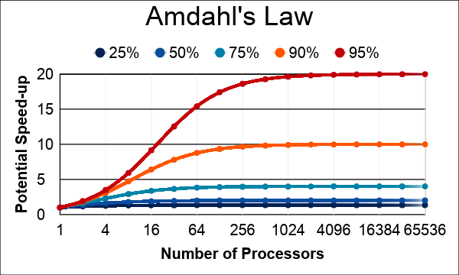
AMDAHL’S LAW
Serialization Limits Performance
Amdahl’s law is an observation that how much speed-up you get from parallelizing the code is limited by the remaining serial part.
Any remaining serial code will reduce the possible speed-up
This is why it’s important to focus on parallelizing the most time consuming parts, not just the easiest.

Slide 16
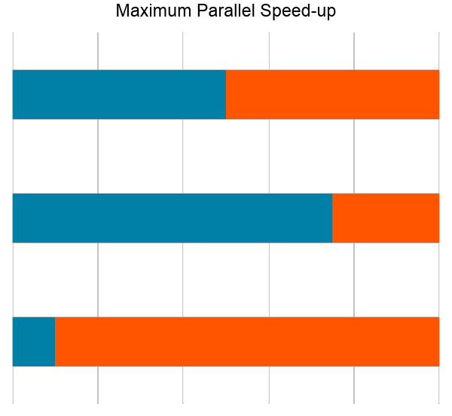
APPLYING AMDAHL’S LAW
Estimating Potential Speed-up
What’s the maximum speed-up that can be obtained by parallelizing 50% of the code?
( 1 / 100% - 50% ) = (1 / 1.0 - 0.50 ) = 2.0X
What’s the maximum speed-up that can be obtained by parallelizing 25% of the code?
( 1 / 100% - 25% ) = (1 / 1.0 - 0.25 ) = 1.3X
What’s the maximum speed-up that can be obtained by parallelizing 90% of the code?
( 1 / 100% - 90% ) = (1 / 1.0 - 0.90 ) = 10.0X
Total Parallel Runtime (50%)
Total Parallel Runtime (25%)
Total Parallel Runtime (90%)
Total Serial Runtime
Notes:
Note: The chart is showing the total runtime when running serially and the runtime when running a percentage of the code infinitely fast in parallel. So, intuitively, parallelizing 50% of the code results in ½ of the runtime or a 2X speed-up.

Slide 17
INTRODUCTION TO OPENACC
Notes:
No coding yet. Just explaining what OpenACC is, it’s weaknesses/limitations, and why it’s worth learning.

Slide 18


OpenACC is a directives-based programming approach to parallel computing designed for performance and portability on CPUs and GPUs for HPC.
Add Simple Compiler Directive
main()
{
<serial code>
#pragma acc kernels
{
<parallel code>
}
}
Notes:
Simple, Powerful, Portable

Slide 19
3 WAYS TO ACCELERATE APPLICATIONS
Applications
Libraries
Compiler Directives
Programming Languages
Easy to use
Most Performance
Easy to use
Portable code
Most Performance
Most Flexibility
OpenACC
Notes:
Libraries are limited by what is included within the library. The programmer is not able to make changes that are not defined in the library. If the programmer needs to do something not defined in the library, there isn’t really a solution for it. This is very high performance, but only if the operations you want to do are available in a library form.
Programming Languages require a programmer to recreate their sequential program from scratch and maintain both serial and parallel versions of their key operations. The programmer can micro-manage everything about their program and often use device-specific features too specific for higher-level approaches in order to achieve the best performance. Parallel programs created in a parallel programming languages tend to only work on a very small number of platforms.
Compiler directives sit in the middle and blend the flexibility of programming languages with the ease of use of libraries. The programmer annotates the code with high-level instructions that a compiler can use to parallelize the code or can safely ignore. This means that a code with compiler directives can be compiled for many different parallel platforms and there’s no need to maintain separate serial and parallel versions of the code.

Slide 20
OPENACC PORTABILITY
Describing a generic parallel machine
Host
Device
OpenACC is designed to be portable to many existing and future parallel platforms
The programmer need not think about specific hardware details, but rather express the parallelism in generic terms
An OpenACC program runs on a host (typically a CPU) that manages one or more parallel devices (GPUs, etc.). The host and device(s) are logically thought of as having separate memories.
Host Memory
Device Memory
Notes:
This is the general OpenACC parallel model. We have a host, which runs our sequential code. This would be a CPU. Then we have our device, which is some sort of parallel hardware. The host and device usually (though not always) have separate memory, and the programmer can use OpenACC to move data between the two memories.

Slide 21
OPENACC
Three major strengths
Incremental
Single Source
Low Learning Curve
Notes:
These are the 3 main aspects of OpenACC. We will break them down one-by-one.

Slide 22
OPENACC
Incremental
Begin with a working sequential code.
Enhance Sequential Code
#pragma acc parallel loop
for( i = 0; i < N; i++ )
{
< loop code >
}
#pragma acc parallel loop
for( i = 0; i < N; i++ )
{
< loop code >
}
for( i = 0; i < N; i++ )
{
< loop code >
}
for( i = 0; i < N; i++ )
{
< loop code >
}
Maintain existing sequential code
Add annotations to expose parallelism
After verifying correctness, annotate more of the code
Parallelize it with OpenACC.
Rerun the code to verify correct behavior, remove/alter OpenACC code as needed.
Notes:
For the most part, we consider OpenACC to be an incremental programming model because we can start with a base, working code. So we start with a working code, then can make small changes until the code is optimal. Many other parallel programming models have you build the code from the ground up. This means that you make large changes at a time, and when something doesn’t work, you either scrap it, or debug it.

Slide 23
OPENACC
Incremental
Single Source
Low Learning Curve
Maintain existing sequential code
Add annotations to expose parallelism
After verifying correctness, annotate more of the code

Slide 24
OPENACC
The compiler can ignore your OpenACC code additions, so the same code can be used for parallel or sequential execution.
Supported Platforms
Single Source
POWER
Sunway
x86 CPU
x86 Xeon Phi
NVIDIA GPU
PEZY-SC
Rebuild the same code on multiple architectures
Compiler determines how to parallelize for the desired machine
Sequential code is maintained
int main(){
...
#pragma acc parallel loop
}
int main(){
...
for(int i = 0; i < N; i++)
< loop code >
}
Notes:
One of the main advantages of OpenACC is that you can run your program on several different parallel hardware without having to make any changes to the code. You may need to make small changes for the code to be optimal, but it is expected that any OpenACC parallel code can run relatively well on any of the supported hardware.

Slide 25
OPENACC
Incremental
Single Source
Low Learning Curve
Rebuild the same code on multiple architectures
Compiler determines how to parallelize for the desired machine
Sequential code is maintained
Maintain existing sequential code
Add annotations to expose parallelism
After verifying correctness, annotate more of the code

Slide 26

OPENACC
CPU
Parallel Hardware
Low Learning Curve
OpenACC is meant to be easy to use, and easy to learn
Programmer remains in familiar C, C++, or Fortran
No reason to learn low-level details of the hardware.
The programmer will give hints to the compiler about which parts of the code to parallelize.
int main(){
<sequential code>
#pragma acc kernels
{
<parallel code>
}
}
Compiler
Hint
The compiler will then generate parallelism for the target parallel hardware.
Notes:
Lastly, OpenACC is meant to be simple to learn/use. Outside of standard C/C++/Fortran coding, there are no new languages to learn.

Slide 27
OPENACC
Incremental
Single Source
Low Learning Curve
Rebuild the same code on multiple architectures
Compiler determines how to parallelize for the desired machine
Sequential code is maintained
OpenACC is meant to be easy to use, and easy to learn
Programmer remains in familiar C, C++, or Fortran
No reason to learn low-level details of the hardware.
Maintain existing sequential code
Add annotations to expose parallelism
After verifying correctness, annotate more of the code
Notes:
So OpenACC is relatively simple to use, and can be a very good resource for anyone to parallelize their existing code. The main tradeoff is in performance. While OpenACC excels in being user-friendly, and developer-friendly, it usually cannot achieve as much performance as a low-level parallel programming model (such as CUDA). This is generally true for any high-level model, as the programmer will just not have the kind of control over their code as they would using a low-level model.

Slide 28



ANSYS FLUENT
GAUSSIAN 16
VASP
Mike Frisch, Ph.D.
President and CEO
Gaussian, Inc.
Sunil Sathe
Lead Software Developer
ANSYS Fluent
Prof. Georg Kresse
Computational Materials Physics University of Vienna
“Using OpenACC allowed us to continue development of our fundamental algorithms and software capabilities simultaneously with the GPU-related work. In the end, we could use the same code base for SMP, cluster/ network and GPU parallelism. PGI's compilers were essential to the success of our efforts.”
“For VASP, OpenACC is the way forward for GPU acceleration. Performance is similar and in some cases better than CUDA C, and OpenACC dramatically decreases GPU development and maintenance efforts. We’re excited to collaborate with NVIDIA and PGI as an early adopter of CUDA Unified Memory.”
“We’ve effectively used OpenACC for heterogeneous computing in ANSYS Fluent with impressive performance. We’re now applying this work to more of our models and new platforms.”
Notes:
Gaussian is quantum chemistry application used to model the electronic structure of atoms and molecules. It’s used by scientists and researchers interested in chemical properties including pharmaceuticals, materials, agrochemicals, and related fields to increase the accuracy of results for small molecular systems, and increase the size of large molecules that can be modeled.
Gaussian has over 2 million lines of mostly Fortran 77 code and has been in development since 1970.
Which makes it really hard to move the code to a new platform and be able to maintain.After learning that OpenACC allows minimal codes changes and delievers performance portability, Gaussian developers decided to start migrating thier code to GPUs using OpenACC.
Gaussian is parallelized with OpenMP (multi-threading) across CPU cores, and in the latest releases with OpenACC for GPU acceleration. Most common use cases (80 – 85%) are GPU-accelerated.
According to Gaussian developers a GPU-accelerated server with 8 P100s that costs only 2x more than a very fast and expensive CPU dual-socket server will deliver 7x performance based on a Valinomycin problem. Making populating a server with GPUs an obvious choice.
ANSYS Fluent is a general-purpose Computational Fluid Dynamics package used to model flow, turbulence, heat transfer, and reactions for industrial applications. Its used primarily by engineers for design and analysis in automotive, aerospace, academia, oil & gas, marine and Formula 1 racing to reduce time to market, create new designs, improve efficiency and reduce costs.
The production release of Fluent now has a Discrete Ordinate Radiation Model that is GPU-accelerated using OpenACC. It’s very high resolution, with 1000’s of scalar equations needed for modeling light beams, all written in C and C++, and runs on Windows or Linux/x86 platforms with GPU accelerators
Speed-ups are about a factor of 3 using 2 P100s vs all 32 cores of a dual-socket Haswell server on this solver, and ANSYS is now working on GPU acceleration of other parts of the codes and ports to other platforms using OpenACC.
VASP is very widely-used at DOE and HPC sites for atomic scale materials modeling – it consumes between 10 and 20% of the compute cycles at the NERSC supercomputer every year. It’s been in development for about 25 years, has close to 500,000 lines of Fortran 90, still some FORTRAN 77. Parallelized using MPI, with OpenMP recently added for multicore CPUs to enable running in hybrid mode.
Some use cases have been GPU accelerated using CUDA C for a couple of years. Not all use cases are ported to GPUs in the CUDA version, and it resulted in different source trees for Fortran vs CUDA C which made it a challenge to keep the CUDA C sources up-to-date with long development cycles to port new solvers. University of Vienna decided to explore an OpenACC port to see if they could get good GPU acceleration in a single-source version of the code. After porting the 1st part of the code developers confirmed little code refactoring was required to use OpenACC and GPU-accelerated libraries. The resulting OpenACC version is generally at least as fast as the CUDA version, and enabled GPU acceleration of parts of the code and use cases that hadn’t yet been ported to CUDA. The VASP developers are in the process of integrating OpenACC into the main development source tree.

Slide 29
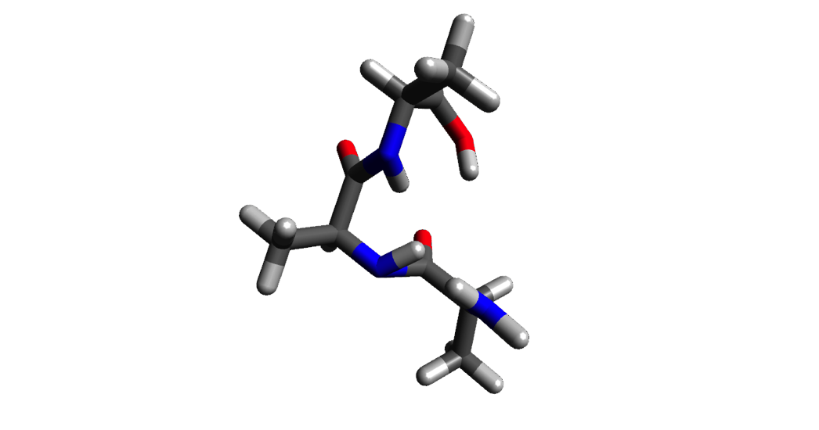






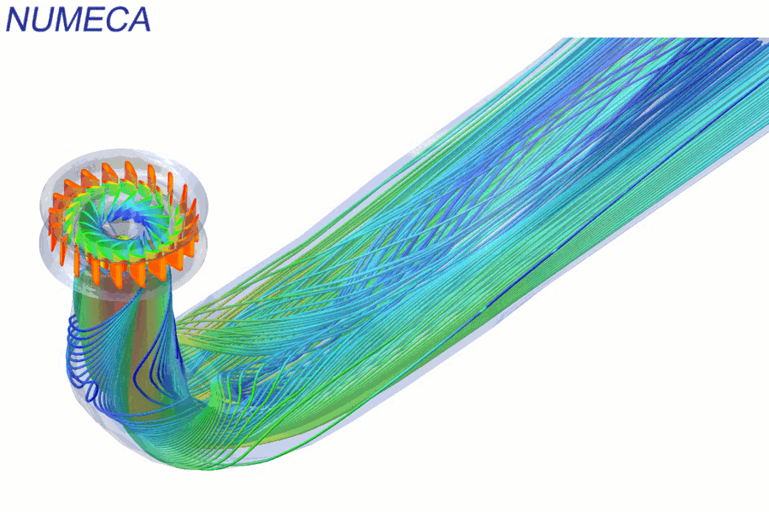
OPENACC SUCCESSES
LSDalton
PowerGrid
COSMO
INCOMP3D
Quantum Chemistry
Aarhus University
12X speedup
1 week
Medical Imaging
University of Illinois
40 days to
2 hours
Weather and Climate
MeteoSwiss, CSCS
40X speedup
3X energy efficiency
CFD
NC State University
4X speedup
MAESTRO
CASTRO
NekCEM
CloverLeaf
FINE/Turbo
Comp Electromagnetics
Argonne National Lab
2.5X speedup
60% less energy
Astrophysics
Stony Brook University
4.4X speedup
4 weeks effort
Comp Hydrodynamics
AWE
4X speedup
Single CPU/GPU code
CFD
NUMECA International
10X faster routines
2X faster app
Notes:
These are some parallel programs that were accelerated with OpenACC
Main points of interest:
Amount of speedup over the sequential version
Runtime differences
Time taken to port the code to OpenACC

Slide 30







OPENACC RESOURCES
Guides ● Talks ● Tutorials ● Videos ● Books ● Spec ● Code Samples ● Teaching Materials ● Events ● Success Stories ● Courses ● Slack ● Stack Overflow
Resources
https://www.openacc.org/resources
Success Stories https://www.openacc.org/success-stories
FREE
Compilers
Compilers and Tools https://www.openacc.org/tools
Events
https://www.openacc.org/events
https://www.openacc.org/community#slack
Notes:
Resources for various things relating to OpenACC. The two recommended, free compilers for OpenACC are PGI and GCC. OpenACC is a new edition to GCC, and all of OpenACC’s features may not be supported yet.

Slide 31
EXPRESSING PARALLELISM WITH OPENACC
Notes:
In this section, we are going to show some simple code examples, and discuss a potential parallel solutions, and then give an idea of how we could parallelize the code in OpenACC. We want to focus on the theory behind parallelism, and we will delve more into the OpenACC implementation in later chapters.

Slide 32
CODING WITH OPENACC
Array pairing example
void pairing(int *input, int *output, int N){
for(int i = 0; i < N; i++)
output[i] = input[i*2] + input[i*2+1];
}
6
3
10
7
2
4
3
8
9
2
0
1
input
9
17
6
11
11
1
output
Notes:
This is the sequential version of a simple pairing function. The input array is full of integers, and we will be reading integers from this array. The output array is what we will write to. The integer N is the size of the output array.
The animations will walk through the loop iterations one-by-one, demonstrating how a sequential program would run.

Slide 33
CODING WITH OPENACC
Array pairing example
subroutine pairing(input, output, N)
do i=1,N
output(i) = input(i*2) + input(i*2+1);
end do
end subroutine
6
3
10
7
2
4
3
8
9
2
0
1
input
9
17
6
11
11
1
output
Notes:
This is the sequential version of a simple pairing function. The input array is full of integers, and we will be reading integers from this array. The output array is what we will write to. The integer N is the size of the output array.
The animations will walk through the loop iterations one-by-one, demonstrating how a sequential program would run.

Slide 34
CODING WITH OPENACC
Array pairing example - parallel
void pairing(int *input, int *output, int N){
for(int i = 0; i < N; i++)
output[i] = input[i*2] + input[i*2+1];
}
void pairing(int *input, int *output, int N){
#pragma acc parallel loop
for(int i = 0; i < N; i++)
output[i] = input[i*2] + input[i*2+1];
}
6
3
10
7
2
4
3
8
9
2
0
1
input
9
17
6
11
11
1
output
Notes:
This is the parallel version of the code. We will do two loop iterations simultaneously, showing that we receive the same results. I would also point out that in this example, we could potentially do all 6 iterations simultaneously and get the correct results.
The last animation of the slide shows the openacc directive that makes our loop behave like this.
I would explain that this is how a parallel loop would theoretically run, and they way we parallelize it in OpenACC is by marking it as “parallel”
We mark loops to be parallel, and let the compiler handle the parallelization. Thanks to the compiler handling most of the difficult work, we could implement this parallel loop on a large number of parallel platforms.
This is because when programming in OpenACC, we are not “parallel programming” in a traditional sense, but rather expressing parts in our code that can be parallel and letting the compiler parallelize it.

Slide 35
CODING WITH OPENACC
Array pairing example - parallel
subroutine pairing(input, output, N)
!$acc parallel loop
do i=1,N
output(i) = input(i*2) + input(i*2+1);
end do
end subroutine
void pairing(int *input, int *output, int N){
for(int i = 0; i < N; i++)
output[i] = input[i*2] + input[i*2+1];
}
6
3
10
7
2
4
3
8
9
2
0
1
input
9
17
6
11
11
1
output
Notes:
This is the parallel version of the code. We will do two loop iterations simultaneously, showing that we receive the same results. I would also point out that in this example, we could potentially do all 6 iterations simultaneously and get the correct results.
The last animation of the slide shows the openacc directive that makes our loop behave like this.
I would explain that this is how a parallel loop would theoretically run, and they way we parallelize it in OpenACC is by marking it as “parallel”
We mark loops to be parallel, and let the compiler handle the parallelization. Thanks to the compiler handling most of the difficult work, we could implement this parallel loop on a large number of parallel platforms.
This is because when programming in OpenACC, we are not “parallel programming” in a traditional sense, but rather expressing parts in our code that can be parallel and letting the compiler parallelize it.

Slide 36
DATA DEPENDENCIES
Not all loops are parallel
void pairing(int *a, int N){
for(int i = 1; i < N; i++)
a[i] = a[i] + a[i-1];
}
1
2
3
3
6
4
10
5
15
6
21
7
28
8
36
9
45
10
55
i=1
i=2
i=3
i=4
i=5
i=6
i=7
i=8
i=9
Notes:
This is a sequential version of a different kind of pairing code. In this version, we are not using an input/output, but instead writing neighbor pairs directly back to the input array. This loop is not a parallel loop, and we will see in the next slide how parallelizing this loop will result in incorrect results.

Slide 37
DATA DEPENDENCIES
Not all loops are parallel
void pairing(int *a, int N){
for(int i = 1; i < N; i++)
a[i] = a[i] + a[i-1];
}
void pairing(int *a, int N){
#pragma acc parallel loop
for(int i = 1; i < N; i++)
a[i] = a[i] + a[i-1];
}
If we attempted to parallelize this loop we would get wrong answers due to a forward dependency.
✓
⌧
⌧
⌧
⌧
⌧
⌧
⌧
⌧
1
3
6
10
15
21
28
36
45
55
Sequential
i=1
i=2
i=3
i=4
i=5
i=6
i=7
i=8
i=9
1
2
3
3
5
4
9
5
9
6
15
7
13
8
21
9
17
10
27
✓
⌧
⌧
⌧
⌧
⌧
⌧
⌧
⌧
Parallel
Notes:
We mark the loop for parallelization using the same directive as before.
We will execute two loop iterations simultaneously.
Each time we execute loop iterations, we can see that we are receiving incorrect results. The top array is our sequential results, and the bottom array is our parallel results. It is easy to see that they differ greatly.
The main thing to note (and why we get incorrect results) is that when executing iterations simultaneously, they’re not waiting for other iterations to write to the array before they read from the array. For example, performing iterations i=1 and i=2 at the same time, iteration i will change the ‘2’ in the array to a ‘3’. The second iteration will not wait for the ‘3’ to be written and will read the ‘2’ instead. This means that memory reads are happening before memory writes, and results in incorrect results.

Slide 38
DATA DEPENDENCIES
Not all loops are parallel
void pairing(int *a, int N){
for(int i = 1; i < N; i++)
a[i] = a[i] + a[i-1];
}
void pairing(int *a, int N){
#pragma acc parallel loop
for(int i = 1; i < N; i++)
a[i] = a[i] + a[i-1];
}
Even changing how the iterations are parallelized will not make this loop safe to parallelize.
✓
✓
✓
✓
✓
⌧
⌧
⌧
⌧
1
3
6
10
15
21
28
36
45
55
Sequential
i=1
i=2
i=3
i=4
i=5
i=6
i=7
i=8
i=9
1
2
3
3
6
4
10
5
15
6
21
7
13
8
21
9
30
10
40
✓
✓
✓
✓
✓
⌧
⌧
⌧
⌧
Parallel
Notes:
This is the same example as before, but we split up the loop iterations differently, to show that even splitting it in different ways will eventually mess up our results. In this example, we break up the array into two halves, and execute each half sequentially. The first half produces the correct results, but the second half doesn’t. This is because the second half relies on the results from the first half. Since the second half was executing before the first half had its results, the answer was determined incorrect.

Slide 39
DATA DEPENDENCIES
Not all loops are parallel
subroutine pairing(a, N)
do i = 1,N
a(i) = a(i) + a(i-1)
end do
end subroutine
1
2
3
3
6
4
10
5
15
6
21
7
28
8
36
9
45
10
55
i=1
i=2
i=3
i=4
i=5
i=6
i=7
i=8
i=9
Notes:
This is a sequential version of a different kind of pairing code. In this version, we are not using an input/output, but instead writing neighbor pairs directly back to the input array. This loop is not a parallel loop, and we will see in the next slide how parallelizing this loop will result in incorrect results.

Slide 40
DATA DEPENDENCIES
Not all loops are parallel
subroutine pairing(a, N)
!$acc parallel loop
do i = 1,N
a(i) = a(i) + a(i-1)
end do
end subroutine
void pairing(int *a, int N){
for(int i = 1; i < N; i++)
a[i] = a[i] + a[i-1];
}
If we attempted to parallelize this loop we would get wrong answers due to a forward dependency.
✓
⌧
⌧
⌧
⌧
⌧
⌧
⌧
⌧
1
3
6
10
15
21
28
36
45
55
Sequential
i=1
i=2
i=3
i=4
i=5
i=6
i=7
i=8
i=9
1
2
3
3
5
4
9
5
9
6
15
7
13
8
21
9
17
10
27
✓
⌧
⌧
⌧
⌧
⌧
⌧
⌧
⌧
Parallel
Notes:
We mark the loop for parallelization using the same directive as before.
We will execute two loop iterations simultaneously.
Each time we execute loop iterations, we can see that we are receiving incorrect results. The top array is our sequential results, and the bottom array is our parallel results. It is easy to see that they differ greatly.
The main thing to note (and why we get incorrect results) is that when executing iterations simultaneously, they’re not waiting for other iterations to write to the array before they read from the array. For example, performing iterations i=1 and i=2 at the same time, iteration i will change the ‘2’ in the array to a ‘3’. The second iteration will not wait for the ‘3’ to be written and will read the ‘2’ instead. This means that memory reads are happening before memory writes, and results in incorrect results.

Slide 41
DATA DEPENDENCIES
Not all loops are parallel
subroutine pairing(a, N)
!$acc parallel loop
do i = 1,N
a(i) = a(i) + a(i-1)
end do
end subroutine
void pairing(int *a, int N){
for(int i = 1; i < N; i++)
a[i] = a[i] + a[i-1];
}
Even changing how the iterations are parallelized will not make this loop safe to parallelize.
✓
✓
✓
✓
✓
⌧
⌧
⌧
⌧
1
3
6
10
15
21
28
36
45
55
Sequential
i=1
i=2
i=3
i=4
i=5
i=6
i=7
i=8
i=9
1
2
3
3
6
4
10
5
15
6
21
7
13
8
21
9
30
10
40
✓
✓
✓
✓
✓
⌧
⌧
⌧
⌧
Parallel
Notes:
This is the same example as before, but we split up the loop iterations differently, to show that even splitting it in different ways will eventually mess up our results. In this example, we break up the array into two halves, and execute each half sequentially. The first half produces the correct results, but the second half doesn’t. This is because the second half relies on the results from the first half. Since the second half was executing before the first half had its results, the answer was determined incorrect.

Slide 42
MODULE 1 REVIEW
Notes:
No coding yet. Just explaining what OpenACC is, it’s weaknesses/limitations, and why it’s worth learning.

Slide 43
CLOSING SUMMARY
Module One: Introduction
Parallel programming is a technique of utilizing modern hardware to do lots of work all at once.
Amdahl’s law is the gravity of parallel programming, break this law at your own peril.
Not all loops are parallel, but often can be rewritten to be parallelizable
OpenACC is a high level model for generating parallel code from serial loops

Slide 44
THANK YOU

